Slide 1
Mortality Prediction in ICU
CSE 6250: Final Presentation
Georgia Institute of Technology
Team 03: Shubhangi Waghere, Divya Paduvalli,
Manuel Novoa,
Winnie Philip

Slide 2
Agenda
Why Mortality Prediction in ICU?
Literature Survey
Our Approach
Data Structure
Data Pre-Processing
Model Environment Set Up
Deep Learning NN Model Architecture
Experiment Results
Conclusion

Slide 3

Why Mortality Prediction in ICU?
Patients suffer from serious emergency illness.
Constant need to be monitored.
High risk of mortality.
Allocation of medical resources.

Slide 4

Literature Survey
Various machine-learning models have been proposed by several researchers to predict mortality. One such research included the use of an ensemble technique called the Super Learner (SL) to improve the performance of mortality prediction. The results of this research had a prediction testing accuracy score of around 95%
In another research study, personalized mortality prediction was done by analyzing similar past patients. Death count among similar patients taken first and then logistic regression and a decision tree was applied. Using logistic regression, the results of AUROC and AUPRC was 0.830 and 0.474 respectively. Using a decision tree, the results of AUROC and AUPRC were 0.753 and 0.347 respectively.
We intend on using a very similar approach by clearly categorizing between similar and non-similar patients by using their feature values. Multivariate logistic regression was applied in another research and the results were AUCROC = 0.85, SMR = 1.25
In multivariate logistic regression, multiple independent variables are taken into consideration to predict the dependent variable.
Typically, for mortality prediction, severity of illness (SOI) scores are used. SOI refers to the physiological decompensation (organ system failures) of a patient.
The true power and value of Apache Spark lies in its ability to execute data science tasks with speed and accuracy. Spark’s selling point is that it combines ETL, batch analytics, real-time stream analysis, machine learning, graph processing, and visualizations.
Notes:
Photo by Lucas Vasques on Unsplash

Slide 5
Our Approach
Most models stated in the literature survey were designed for at least 24 hours or 48 hours after ICU admission to provide real-time or retrospective prediction on patient mortality.
In this study, we propose a two-phase model framework to address the task of predicting the mortality and also death hours in the early stage of ICU stay timeframe.
If a patient is predicted dead in the first phase, our models would further provide an estimate of death hours since ICU admission in the second phase.
Our goal is to identify high-risk patients who might be dead within hours or days since ICU admission.
Data was pre-processed and extracted for the 24 hour period since ICU admission for each ICU stay from MIMIC-III database.
Multiple models were trained on the extracted features of the study population for the specified timeframe.
1
2
Predict Mortality
Predict Death Hours
Previous studies have reported conflicting results on whether pulmonary radiographic findings predict mortality for patients.
When confronted with approaching death, many of us wonder when exactly will death occur.

Slide 6
System Specifications
Our study consists two stages of implementation:
Feature engineering using Hadoop HDFS, and PySpark on Local Docker MAC OS environment (1 Master node and 2 worker nodes, each with 900 GB space, 14 GB RAM, and 4 processors).
Machine learning using Python 3.6 on a local cluster (500 GB space, 16GB RAM, 4 GB CPU and 4 processors).
The decompressed dataset of MIMIC-III requires around 50 GB of space.
We chose big data tools namely:
Apache Hadoop/HDFS and
PySpark
Data output in the first stage is then used as feature input for the model training in the second stage.
We also used Python and packages such as Keras, Pandas and Scikit-learn for efficient model testing, hyperparameter tuning and model evaluation.
All the dependencies for the execution of this project has been defined in the conda environment definition added in the root of the project (environment.yml).

Slide 7
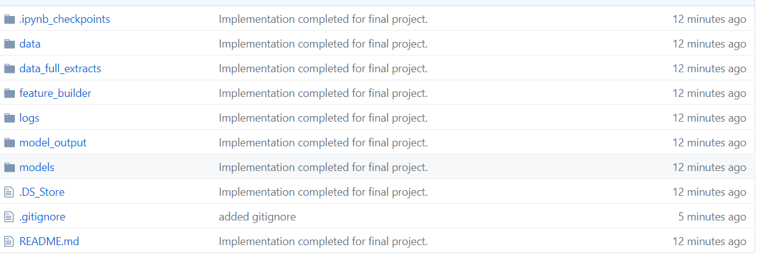
Github Code Structure
https://github.gatech.edu/manp6/cse-6250-team-03-final-project/tree/master

Slide 8
MIMIC-III Mortality Datasets
A total of 26 dataset in the MIMIC-III database consists of 61,532 distinct ICU stays of 46,520 unique patients.
To form our study population, we have included all ICU stays to analyze the data of unusual short stays and only consider all patients.
The final study population covered 49,632 ICU stays of 36,343 patients.
Multiple machine learning models in this study have been trained and evaluated based on this study population.
5,718 records consisted of in-hospital mortality information.
Table 1 in the report provides summary statistics of the study population.
62.61%
57.79%
71%
Age
Gender
Ethnicity
82.31%
1.37%
11.62%
Admission type
Number of ICU stays
In-hospital mortality ratio

Slide 9
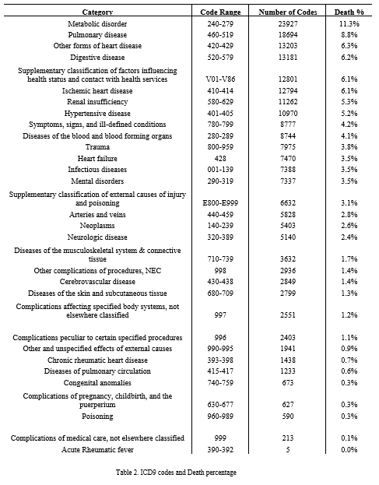
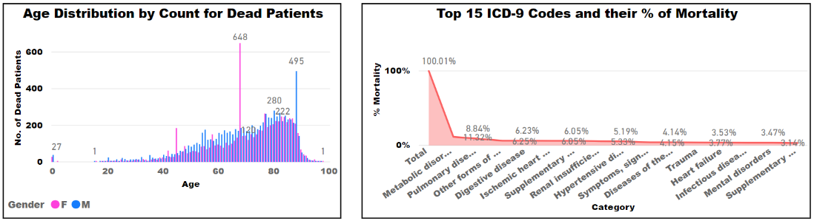
MIMIC-III Mortality Datasets Continued.
Among 49,633 ICU stays, there are 5,766 in-hospital mortality.
After filtering out the ICU stays with negative death time since ICU admission (which is likely an administrative error resulting in an incorrect ICU admission or incorrect death time), 5,718 in-hospital mortality were resulted.
The average death time since ICU admission is 9.57 days, maximum death time is 206.38 days and minimum death time is 0 day.
Below line and clustered chart (Age Distribution by Count for Dead Patients) shows perfect distribution of deaths by age and as per the trends in the graph, most of the deaths happen between ages 55-85. Age groups 20-40 has less death rate but still the number is in the range of 100-200.

Slide 10
Data Pre-Processing
We have a total of 26 datasets downloaded from the MIMIC III database.
These datasets have a mixture of both categorical and continuous variables. Since the total size of the datasets is around 43.3 GB with over a million records, we used Hadoop Spark to automate the process of data extraction.
Our algorithm was inspired by the homework assignments and the benchmarking techniques used in the Multitask Learning and Benchmarking with Clinical Time Series Data research paper.
Despite using spark, the overall data extraction process was computationally very expensive. Each patient in the database are referred to as subjects and are given a unique subject ID.
We created folders for each subject ID and in each folder, we stored specific patient information that will aid in predicting the mortality.
Subject’s hospital stays, diagnosis, and events information was stored in each of those folders.
The figure 1 in the report shows the attributes from each of the csv files used and its descriptions.
Attributes are a mixture of demographic information (such as age, date of birth, etc.) and technical information (such as mortality, the name of the illness, etc.) about the illness that the patient was suffering from.
Eventually, this will aid in our analysis to answer questions like, is there a specific risk for people belonging to a certain age or ethnicity to suffer from a particular illness? Does frequent visit to the hospitals or longer hospital stays indicates that the patient’s health is deteriorating and may increase the chance of mortality.
Every time a subject is admitted to the ICU, their ICU stay is represented with an ICU stay ID. A subject may have multiple ICU stay IDs which indicates that they have been admitted to the ICU multiple times.
All the subject level ICU stay information csv files were distributed to three folders namely, Train (60% ~14,681), Validation (20% ~ 3,222), and Test (20% ~ 3,236). In this process, three separate csv files were generated namely, train_listfile, val_listfile, and test_listfile. These 3 csv files contains the names of all the ICU stay csv files in the three folders and their corresponding mortality information represented by 0 (dead) and 1 (alive). We have ran our machine learning models on the full data set.

Slide 11
Model Architecture
In phase 1 and phase 2, we trained and experimented with feature rich MIMIC III data sets using a combination of classification and deep learning keras models namely: Logistic Regression, Random Forest, Artificial Neural Network (ANN), Convolutional Neural Network (CNN), and Long Short-Term Memory Network (LSTM).
We finalized two keras deep learning frameworks in Python for our machine learning model evaluation in Phase 2.
The figure 2.b shows the popularity of Keras API.
We trained our models using train data size of 14681* 714, validated using 3222*714, and tested using test set of size 3236*714.
The training dataset was of reasonable size to run on a local laptop MAC OS environment, therefore we chose to train model in Spyder/Anaconda Python 3.6 environment, and capture the results log in HTML form for further review.
Figure 2.b shows deep learning frameworks ranking computed by Jeff Hale, based on 11 data sources across 7 categories.
Notes:
Keras is an open source machine learning API framework that can run on top of Theano, Tensorflow, or CNTK framework.
Karas APIs are simple to use and to understand the machine learning problem and in addition, we get the full ability of its underlying powerful deep learning architecture.
We chose to run Keras model on top of Tensorflow.

Slide 12
Deep Learning NN Model Architecture
ANN Architecture: Layer (type) Output Shape Param # ================================================================= dense_96 (Dense) (None, 714) 510510 _________________________________________________________________ dropout_50 (Dropout) (None, 714) 0 _________________________________________________________________ dense_97 (Dense) (None, 1428) 1021020 _________________________________________________________________ dropout_51 (Dropout) (None, 1428) 0 _________________________________________________________________ dense_98 (Dense) (None, 1428) 2040612 _________________________________________________________________ dropout_52 (Dropout) (None, 1428) 0 _________________________________________________________________ dense_99 (Dense) (None, 1) 1429 ================================================================= Total params: 3,573,571 Trainable params: 3,573,571 Non-trainable params: 0 | CNN Architecture: _______________________________________ Layer (type) Output Shape Param # ================================================================= conv1d_13 (Conv1D) (None, 712, 32) 128 _________________________________________________________________ max_pooling1d_13 (MaxPooling (None, 356, 32) 0 _________________________________________________________________ conv1d_14 (Conv1D) (None, 354, 32) 3104 _________________________________________________________________ max_pooling1d_14 (MaxPooling (None, 177, 32) 0 _________________________________________________________________ flatten_7 (Flatten) (None, 5664) 0 _________________________________________________________________ dense_92 (Dense) (None, 32) 181280 _________________________________________________________________ dense_93 (Dense) (None, 1) 33 ================================================================= Total params: 184,545 Trainable params: 184,545 Non-trainable params: 0
Notes:
ANN/CNN Keras Deep learning Framework on top of TensorFlow

Slide 13
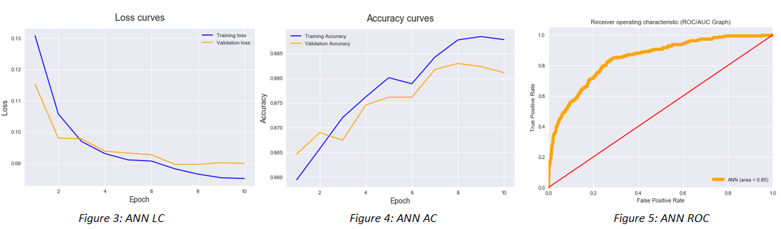
Experiment Results for ANN
ANN model is trained and validated on the dataset for 10 epochs to give a quick view of the model's working.
The robustness of model increases along with the decrease of the value of loss function.
Training Loss gradually decreases and stabilizes at ~0.04.
Validation Loss also reduces with training loss. Loss curve states that the model is neither overfitting nor under fitting.
Accuracy Curves helps in notifying the score accuracy of prediction.
Figure 3: ANN LC states the training loss and validation loss which starts from ~0.13
Figure 4: ANN Accuracy denotes that the validation accuracy is between 0.882-0.884 i.e. model can predict even for the new unseen data with most accuracy.
Figure 5: ANN ROC gives a smooth AUC curve which covers an area of about 0.85. It gives the notion of a positive learning model.

Slide 14
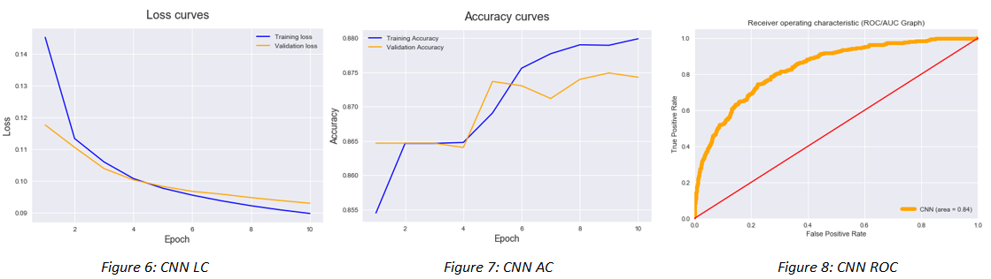
Experiment Results for CNN
Figure 6 CNN LC plots the Training Loss and Validation Loss.
Model trains quickly with the training data as the training loss touches 0.08 before 40 epochs and goes on decreasing further.
Validation loss goes down towards 0.09 and below.
This gives a very fine-tuned binary classifier for mortality prediction.
Training accuracy in figure 7 CNN AC reaches 0.895 before 40 epochs.
Validation accuracy continuously increases and attains 0.885 which states the correct positive prediction.
Area under the AUC/ROC Curve determines the working of the model.
CNN model built with specific configurations which gives the area of 0.85 and curve almost touching the top-left corner of the graph.

Slide 15
Conclusion
Although the models trained on the data in the first 24-hour since ICU admission give better performance, the first 6 hours of ICU data provides enough information for mortality prediction and a rough estimate of death hours since ICU admission.
The proposed framework provides a base to promptly identify high-risk patients who might be dead within hours or days since ICU admission in the early stage of ICU stay, and there are potential avenues for improvement.

Slide 16
- THANK YOU -

